Slide 1
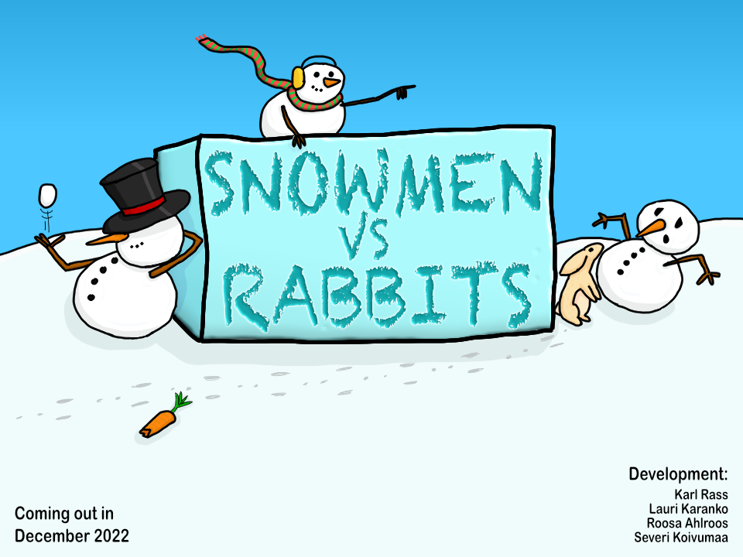

Slide 2
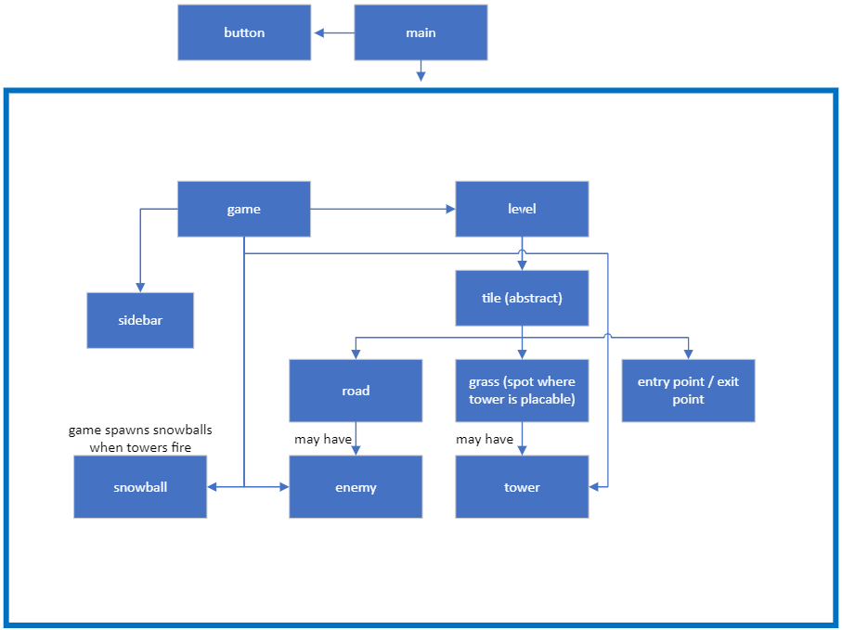


Design
C++ libraries
SFML
MinGW, G++, Clang++
Valgrind
GDB Debugger

Slide 3
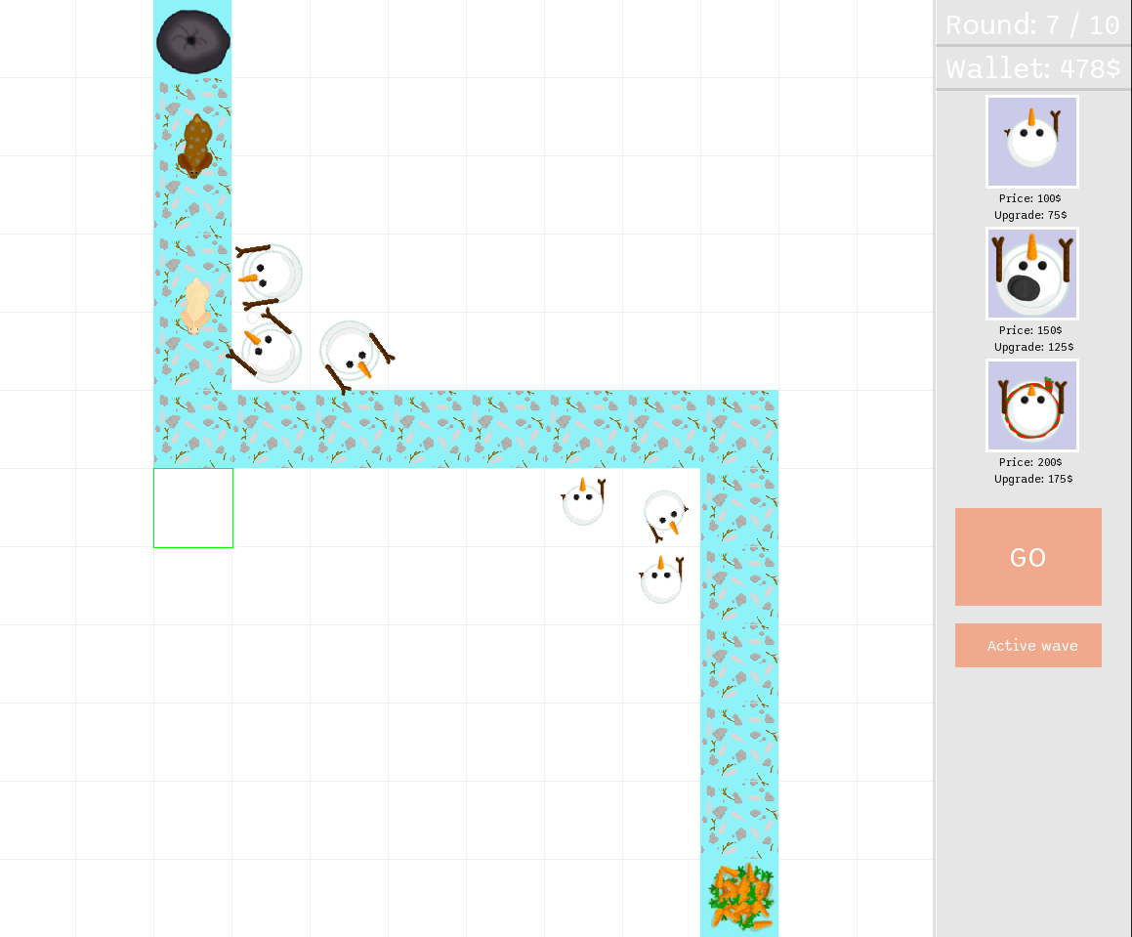
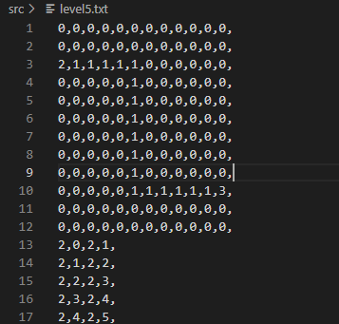
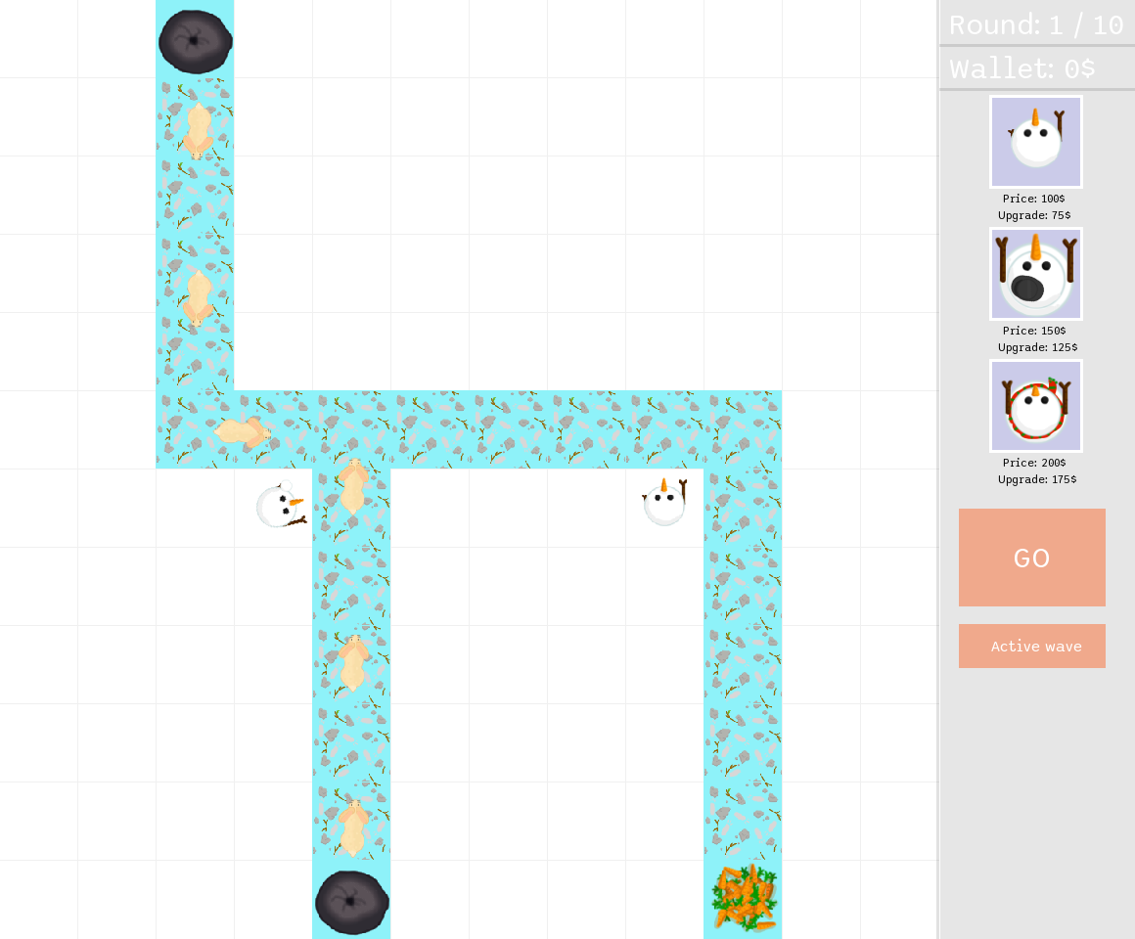
Features
Non-hardcoded maps
Upgradable towers
Tower placement that can be altered during an enemy wave
Sound effects (music in our case)
Multiple paths for enemies
Level editor*

Slide 4
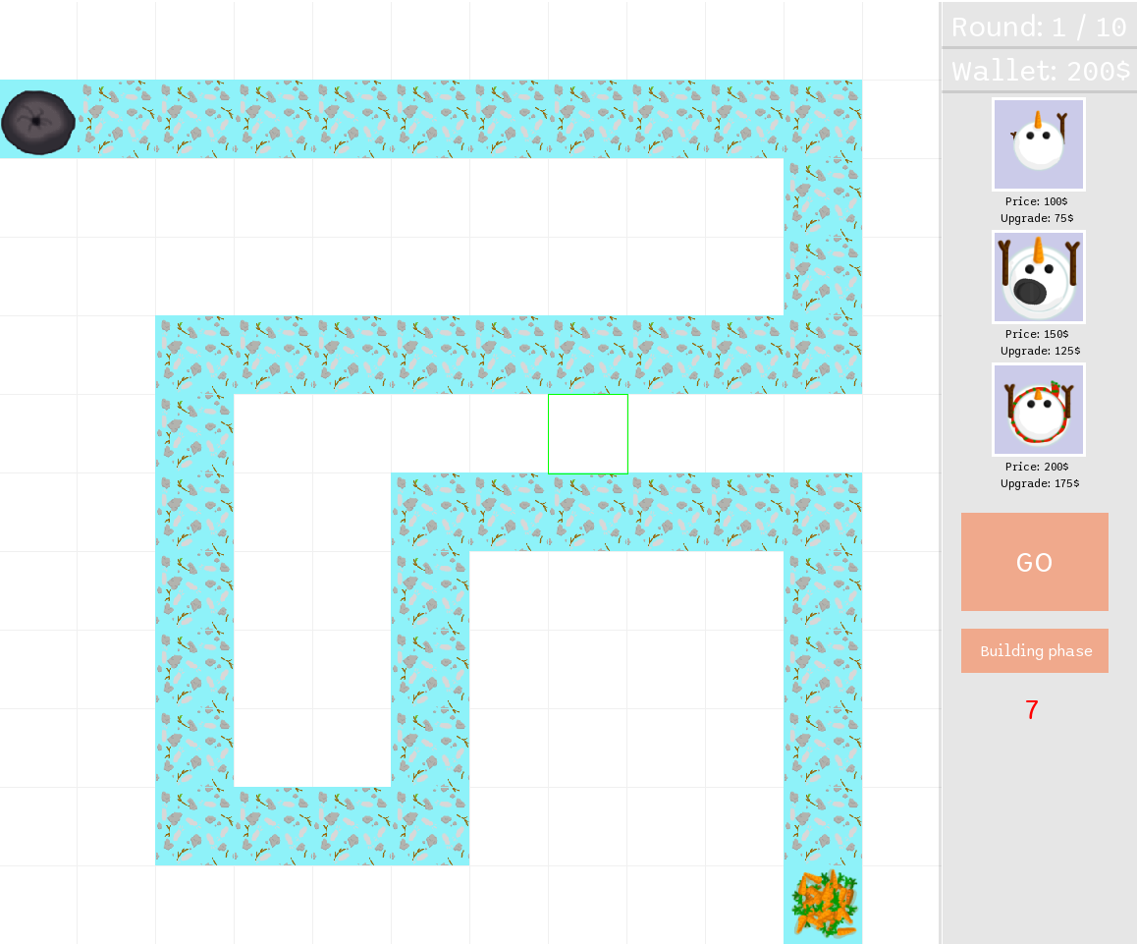
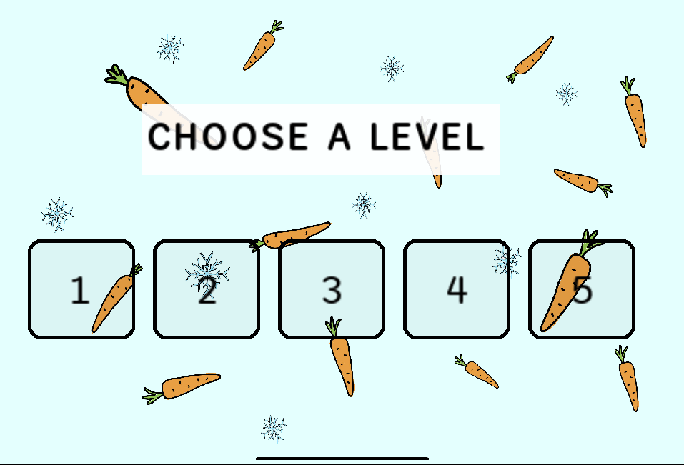
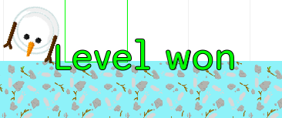
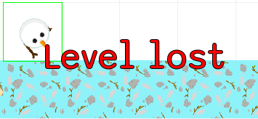


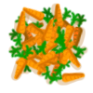



Working practices
Weekly meetings on Teams / campus
Extra meetings when needed
Constant chatting on telegram
Frequent pushes to Git

